Slide 1

AI-Powered Invoice Processing & Entity Extraction Platform
Team Members
• Krishnan
• Madhesh
• Purusothaman
• Infant
• Manoj
Notes:
Good [morning/afternoon] everyone. We're presenting our project, "AI-Powered Invoice Processing and Entity Extraction Platform." I'm [name], along with my teammates Krishnan, Madhesh, Purusothaman, Infant, and Manoj.

Slide 2

Abstract
Automation
Hybrid AI Stack
Transform manual accounts payable into touchless, auditable workflows to reduce cost and latency.
Combine Tesseract OCR with LLM parsing (Gemini / Llama 3) for precise entity extraction and semantic understanding.
Interactive UX
Streamlit dashboard enables validation, correction, export, and monitoring in real time.
Notes:
Our project automates accounts payable, turning manual work into touchless, auditable workflows. We use a hybrid AI stack — Tesseract OCR combined with LLMs like Gemini and Llama 3 — for accurate, context-aware entity extraction. A Streamlit dashboard lets users validate, correct, export, and monitor everything in real time.

Slide 3

Project Overview
Problem
Manual invoice entry is labor-intensive, costly, slow, and error-prone—creating delays and reconciliation headaches.
Solution
An automated pipeline that ingests PDFs/images, extracts vendor, dates, line-items, totals, taxes, and outputs validated JSON/CSV for accounting systems.
Goal
Deliver a scalable, secure, user-friendly platform that raises data quality and reduces AP cycle time.
Notes:
Manual invoice entry is slow, costly, and error-prone, causing delays and reconciliation issues. Our solution ingests invoices as PDFs or images, extracts vendor details, dates, line items, totals, and taxes, and outputs clean JSON/CSV for accounting systems. The goal: a scalable, secure platform that boosts data quality and cuts AP cycle time.

Slide 4

Existing System: The Manual Hurdle
High Operational Cost
Dedicated teams required for typing, verification, and correction.
Inefficient Turnaround
Latency between receipt and ERP entry causes payment delays and cash-flow issues.
Error-Prone
Human mistakes on invoice numbers, amounts, and tax calculations require rework.
Scalability Limits
Difficulty handling spikes in vendor volume or multi-format documents.
Notes:
The current manual process has four major issues: high operational cost from dedicated data-entry teams, slow turnaround causing payment delays, frequent human errors needing rework, and poor scalability during volume spikes or format changes.

Slide 5

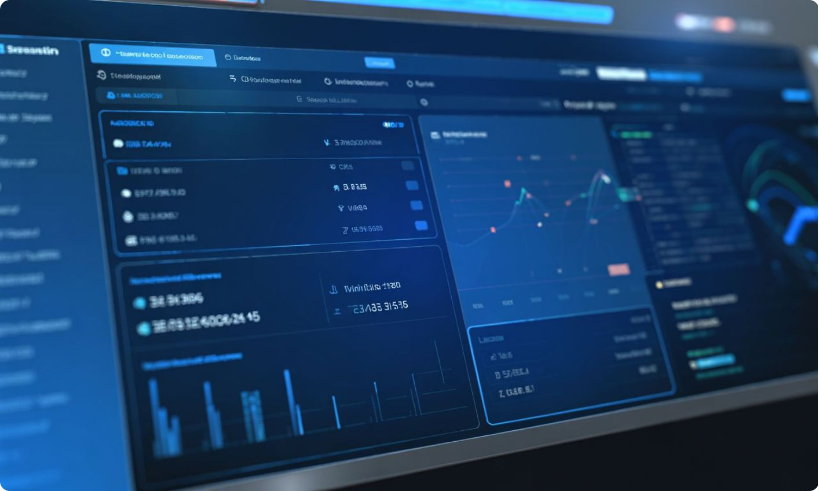
Proposed System: Intelligent Automation
Pipeline highlights from ingestion to export:
1
2
1. Pre-processing
2. OCR Layer
Image enhancement (grayscale, denoise, de-skew), PDF rasterization, and DPI normalization.
Tesseract or PaddleOCR produces raw text with layout coordinates.
3
4
3. AI Engine
4. Interface
LLMs (Gemini / Llama 3 via Ollama) perform semantic parsing into structured JSON.
Streamlit dashboard for human-in-the-loop validation, analytics, and export.
Notes:
Our pipeline has four stages. Pre-processing enhances image quality and normalizes PDFs. The OCR layer extracts raw text with layout coordinates. The AI engine uses LLMs to semantically parse this into structured JSON. Finally, the interface — a Streamlit dashboard — enables human validation, analytics, and export.

Slide 6


The Mechanism Behind the Magic
Document Ingest
OCR & Layout
LLM Semantic Parsing
Validation & Export
Key components: layout analysis to find tables/headers, LLM-based semantic parsing for context-aware entity extraction, confidence scoring to triage human review, and rule-based validation against business logic and expected CSV schemas.
Notes:
The flow moves from document ingestion, to OCR and layout analysis, to LLM-based semantic parsing, to validation and export. Key components include layout analysis for tables and headers, context-aware LLM extraction, confidence scoring to flag uncertain results, and rule-based validation against business schemas.

Slide 7




Future Enhancements
ERP Integration
Advanced Analytics
Document Expansion
Cloud Scalability
Bi-directional syncing with SAP, QuickBooks, and Netsuite for automatic posting and reconciliation.
Vendor spend trends, anomaly detection, and predictive payment forecasting.
Extend extraction to receipts, multi-page contracts, and non-invoice financial documents.
Containerized microservices with autoscaling, batch processing, and job orchestration.
Notes:
We plan to add ERP integration with SAP, QuickBooks, and NetSuite; advanced analytics like spend trends and anomaly detection; expanded document support beyond invoices; and cloud scalability through containerized, autoscaling microservices.

Slide 8


Conclusion
Efficiency & Accuracy
Hybrid OCR + LLM pipeline significantly reduces manual effort and improves data fidelity.
Human-in-the-Loop
Confidence scoring and Streamlit validation balance automation with oversight for auditable results.
Business Impact
Faster AP cycles, lower costs, and cleaner data enable better financial decision-making.
Theme colors used: #1A2D7A (primary), #D3DCF6, #E7EEF9 for emphasis and visual consistency.
Notes:
Our hybrid OCR-LLM pipeline improves efficiency and accuracy while cutting manual effort. Human-in-the-loop validation keeps results auditable. The business impact: faster AP cycles, lower costs, and cleaner data for better financial decisions. Thank you.

